Slide 1
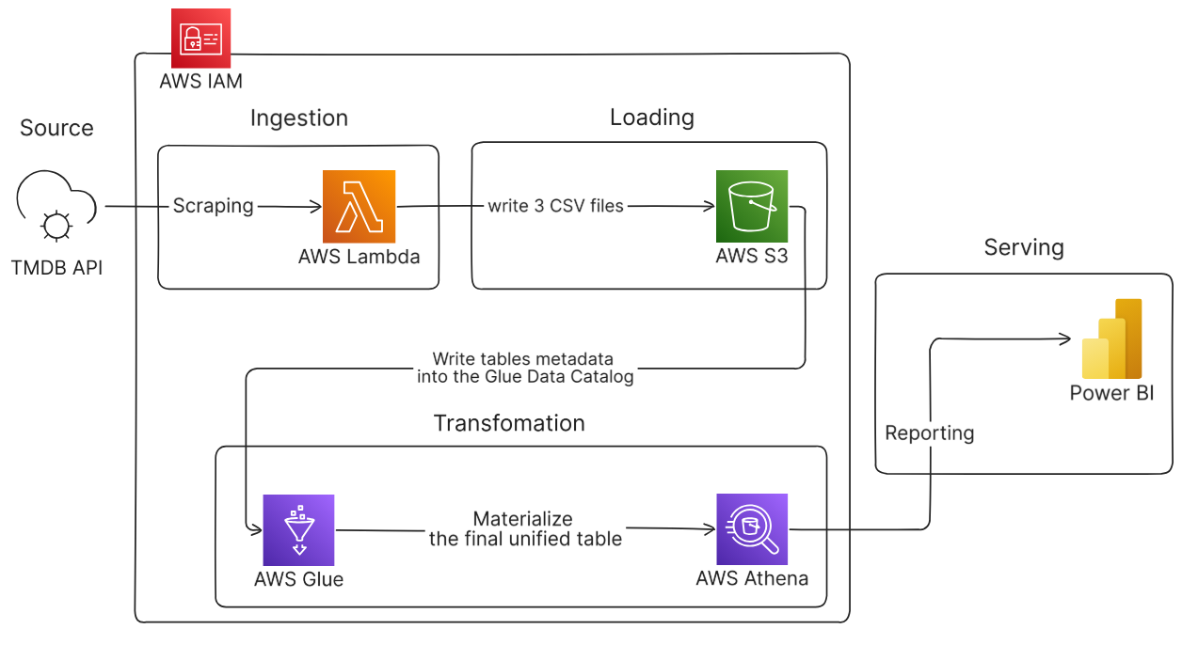

Slide 2
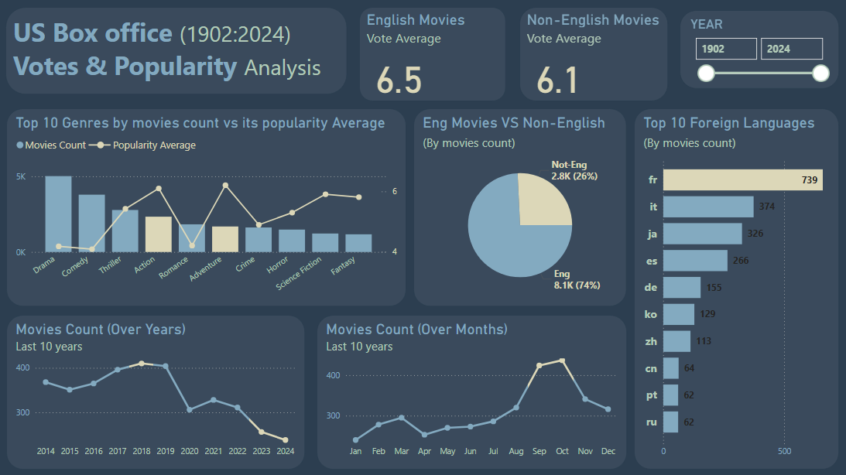

Slide 3
Hollywood in the Cloud
An End-to-End Data Pipeline for Box Office Analysis
(22 nov 2025)
-: Presenter :-
Maher Mahmoud Maher

Slide 4
? Project Overview & Objectives
󠁯•󠁏󠁏 The Goal :
To build a fully automated, serverless data pipeline to ingest, process, and analyze over 100 years of US Box Office data (1902-2024).
󠁯•󠁏󠁏 Key Questions :
What are the long-term trends in movie production?
Which genres are most common vs. most popular?
How do English and Non-English films compare?
What are the most popular foreign languages in film?
󠁯•󠁏󠁏 Target Audience & Stakeholders :
1- Production Studios – green-lighting new projects
2- Film Distributors – picking peak release windows

Slide 5
Workflow Chart

Slide 6
Proposed Tech Stack
An End-to-End Cloud Data Pipeline
Security | AWS IAM | Creating the roles with the needed permissions
Ingest | AWS Lambda | Fetches data from API.
Load | AWS S3 | Raw CSVs stored in S3 Data Lake.
Transform | AWS Glue | Crawls metadata and cleans data.
Serve | AWS Athena | Queries the optimized table.
Visualize | MS Power BI | Consumes data via Athena.

Slide 7
Some of faced Challenges
AWS IAM | Selecting the needed permissions for each role
AWS Lambda | Timed out the code from 3sec to 15min Adding the Environment Variables
AWS S3 | Splitting each lambda csv output into separated locations for the crawlers sake (mandatory)
AWS Glue | Configuring the glue crawlers (one per each csv) for parsing the schema
AWS Athena | Creating the unified Table that will be stored in s3
MS Power BI | Using the ODBC service to connect with Athena

Slide 8
Data Storytelling (The Dashboard)

Slide 10
Some of the Key insights
󠁯•󠁏󠁏 Quality vs. Quantity :
Drama and Comedy have the highest volume, but Adventure and Action hold the highest popularity ratings.
󠁯•󠁏󠁏 Seasonality :
The industry clearly targets Q4 (Oct/Nov) for peak releases, likely aiming for holiday audiences and award seasons.
󠁯•󠁏󠁏 Language Trends :
French is the dominant foreign language in the US market (739 films), nearly double that of Italian or Japanese.

Slide 11
THANK YOU
Any questions?

